Slide 1
Veterinarian Database
By: Colin Gamroth
Jenny Xie

Slide 2
Description
We designed a database for appointments at a veterinarian hospital with the entities staff, animal, appointment, and customer. This database tracks the appointments/animal patients that arrive at the veterinarian.

Slide 3
Business Rules & Constraints
A customer can make multiple appointments but they can not be at the same time and date.
Staff can only work at a single location
An animal must be registered to a customer to be able to be tracked
A customer must have at least one animal
An animal can only be registered to one customer
Only open from 9:00 am to 5:00 pm

Slide 4
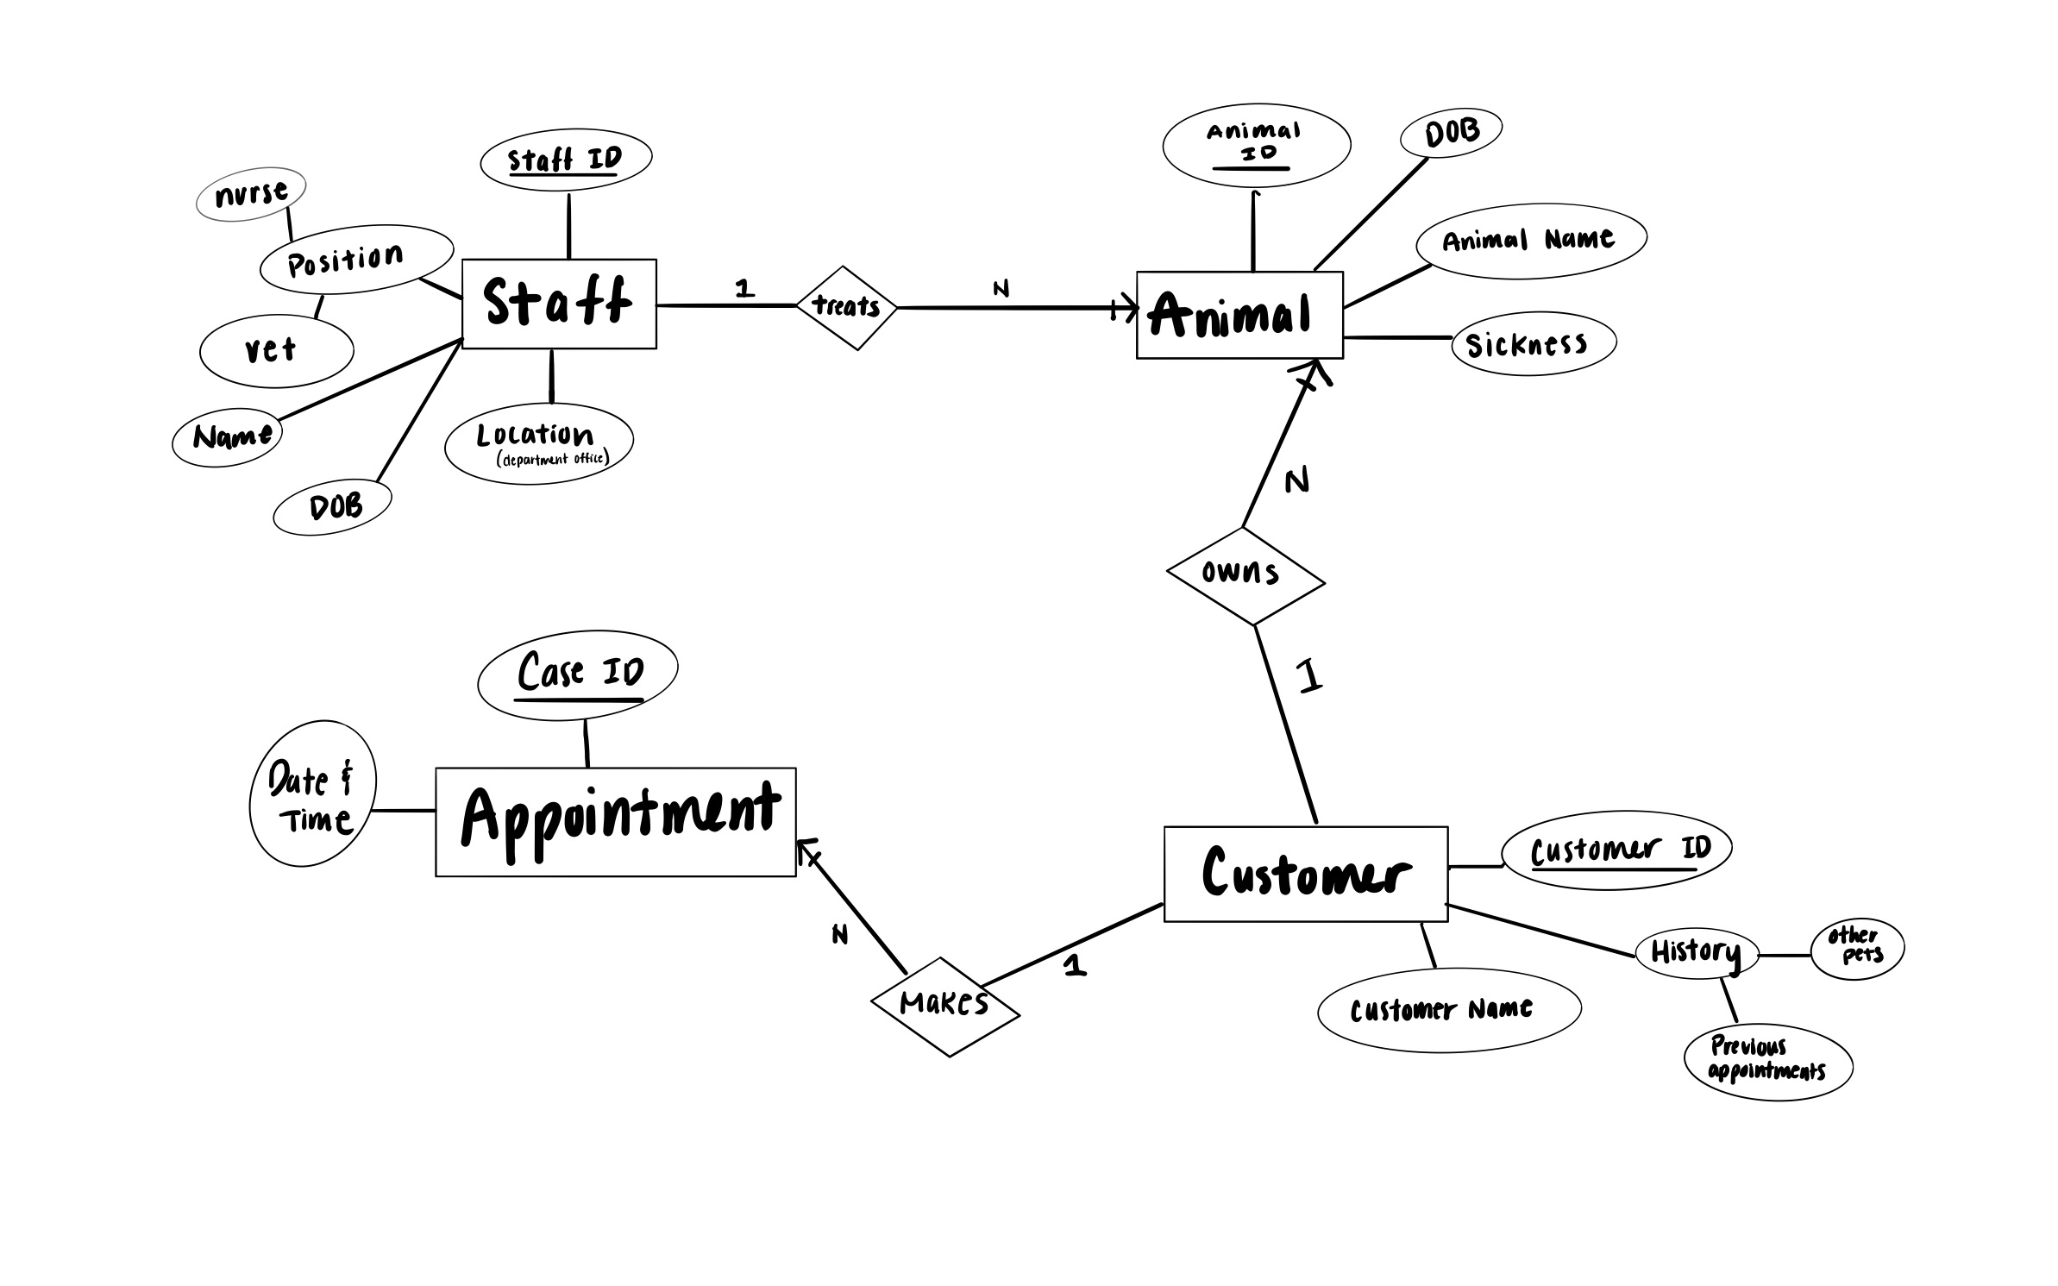
ER Diagram - Version 1

Slide 5
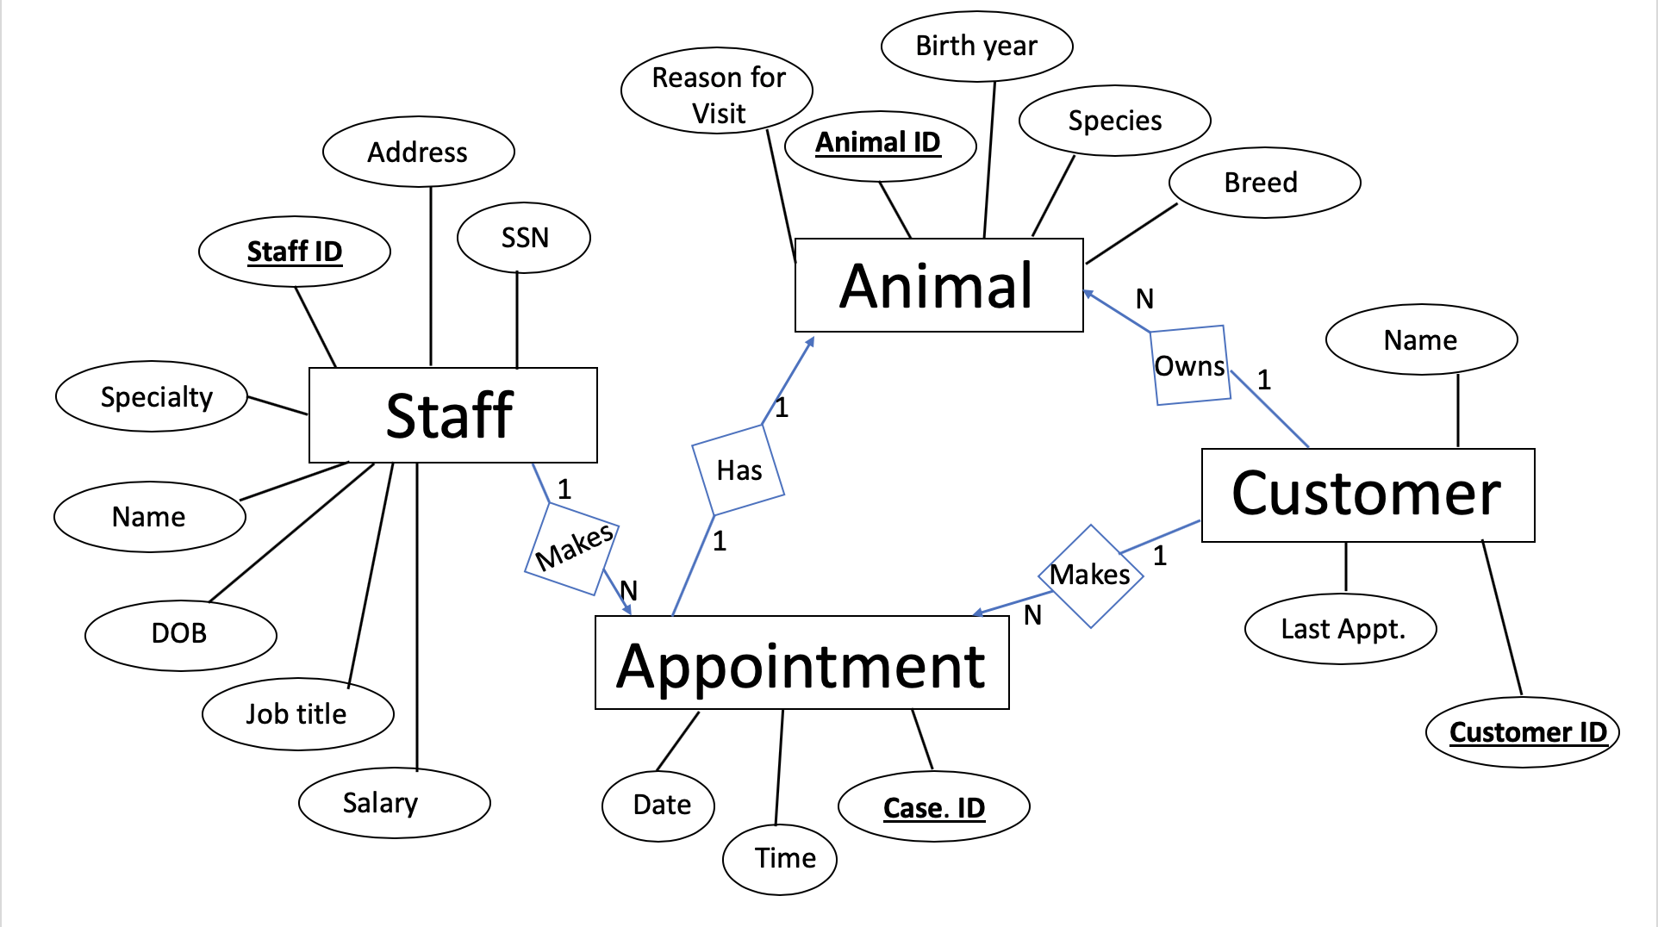
ER Diagram - Final

Slide 6
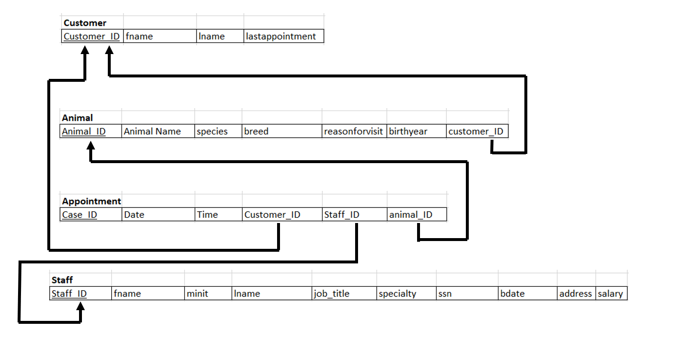
Schema Representation

Slide 7
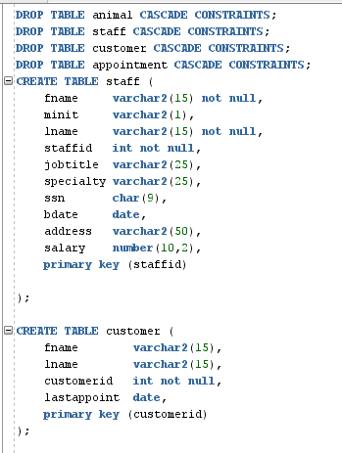
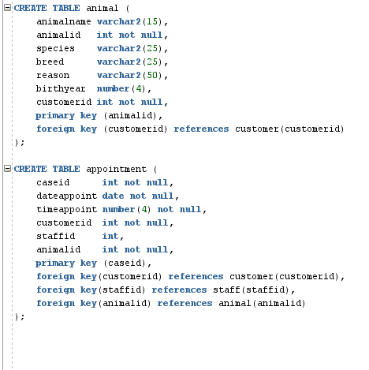
Schema.sql

Slide 8
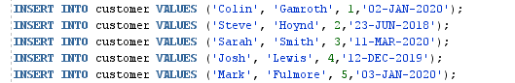
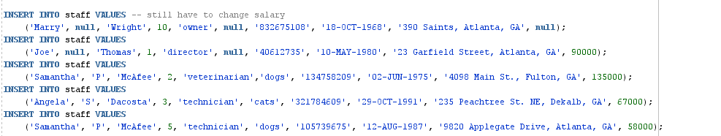
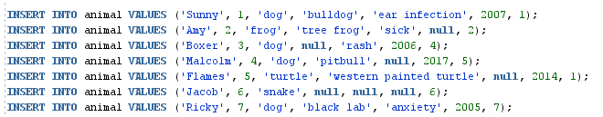

Data.sql

Slide 9
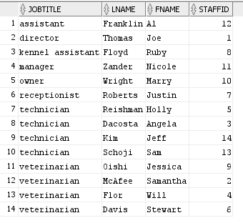
Query: List Staff by Job Title
SELECT JOBTITLE, LNAME, FNAME, STAFFID
FROM STAFF
ORDER BY JOBTITLE;

Slide 10

Query: List all staff with dog specialty
SELECT LNAME, FNAME, STAFFID
FROM STAFF
WHERE SPECIALTY = 'dogs'
ORDER BY LNAME;

Slide 11

Query: Find the customer and last appointment of the animal named Flames
SELECT FNAME, LNAME, LASTAPPOINT
FROM CUSTOMER
WHERE CUSTOMERID =
(SELECT CUSTOMERID FROM ANIMAL WHERE ANIMALNAME = 'Flames');

Slide 12

Query: Find the name and specialty of the staff for Boxer’s appointment
SELECT FNAME, LNAME, SPECIALTY
FROM STAFF
WHERE STAFFID =
(SELECT STAFFID FROM APPOINTMENT WHERE ANIMALID =
(SELECT ANIMALID FROM ANIMAL WHERE ANIMALNAME = 'Boxer'));

Slide 13
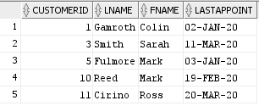
Query: Listing all appointments in 2020
SELECT CUSTOMERID, LNAME, FNAME, LASTAPPOINT
FROM CUSTOMER
WHERE LASTAPPOINT LIKE '_______20%'
ORDER BY CUSTOMERID;

Slide 14
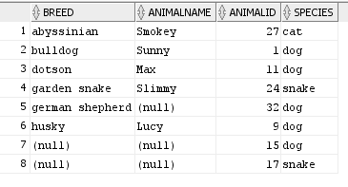
Query: List the breeds of animals with their name, ID, and species that had an appointment in May 2020
SELECT BREED, ANIMALNAME, ANIMALID, SPECIES
FROM ANIMAL
WHERE ANIMALID IN(SELECT ANIMALID
FROM APPOINTMENT
WHERE DATEAPPOINT LIKE '___MAY-20%')
ORDER BY BREED;

Slide 15
Thank you!
Any questions?

